Slide 1
NeuralNet 101
2. Linear Regression

Slide 2
What is Linear Regression?
Estimating the mean in multi variable data
with Linear function

Slide 3
What is Linear Regression?
Estimating the mean in multi variable data
with Linear function

Slide 4
When do we use Linear Regression?
X ?

Slide 5
When do we use Linear Regression?
X ?

Slide 6
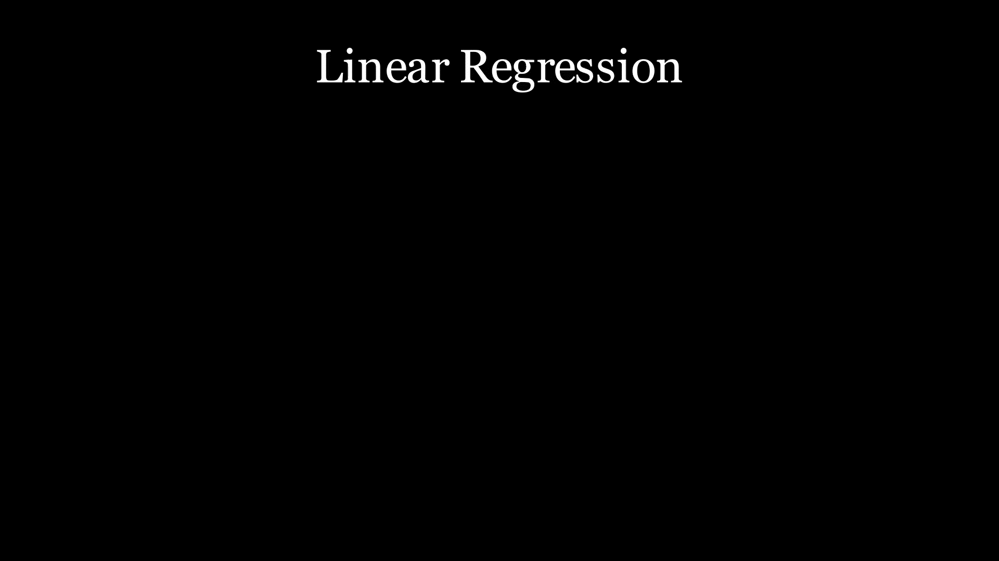
When do we use Linear Regression?
https://youtu.be/0YpNPG46nIw

Slide 7
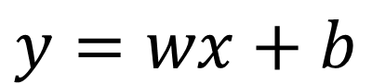
Linear Function
$$y=wx+b$$
X ?

Slide 8
Find w, b
$$y=wx+b$$
X ?

Slide 9
Error
$$y=wx+b$$

Slide 10
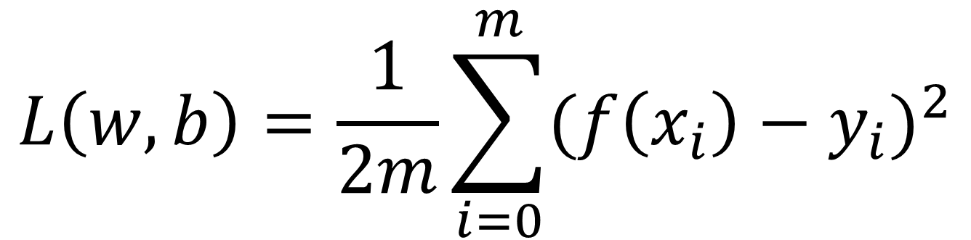
Error Function
$$L\left(w,b\right)=\frac{1}{2m}\sum_{i=0}^{m}{(f\left(x_{i}\right)−y_{i})^{2}}$$

Slide 11

Error Function
https://youtu.be/QN2esfrzHHI

Slide 12
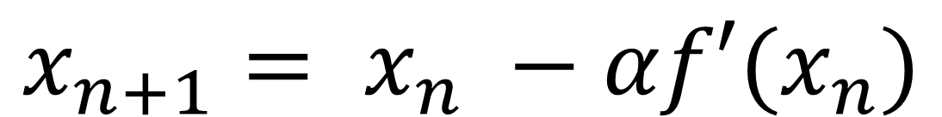
Gradient Descent (Last Lecture)
$$x_{n+1}= x_{n} −αf′(x_{n})$$

Slide 13
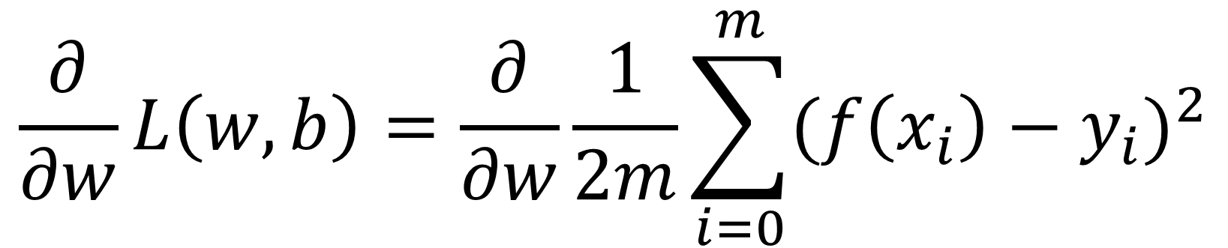
Differential
$$\frac{∂}{∂w}L\left(w,b\right)=\frac{∂}{∂w}\frac{1}{2m}\sum_{i=0}^{m}{(f\left(x_{i}\right)−y_{i})^{2}}$$

Slide 14
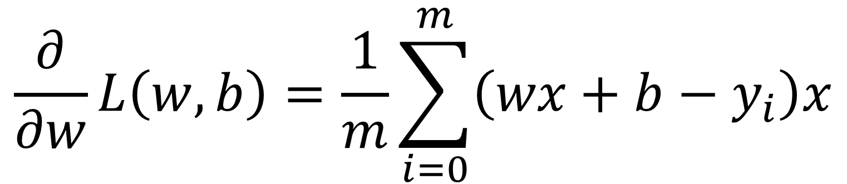
Differential
$$\frac{∂}{∂w}L\left(w,b\right)=\frac{1}{m}\sum_{i=0}^{m}{\left(wx+b−y_{i}\right)x}$$

Slide 15
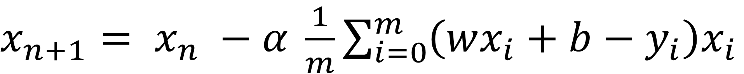
Gradient Descent (Last Lecture)
$x_{n+1}= x_{n} −α$ $\frac{1}{m}\sum_{i=0}^{m}{\left(wx_{i}+b−y_{i}\right)x_{i}}$

Slide 16

Gradient Descent (Last Lecture)
$w_{n+1}= w_{n} −α$ $\frac{1}{m}\sum_{i=0}^{m}{\left(wx_{i}+b−y_{i}\right)x_{i}}$

Slide 17
Loss Function
https://youtu.be/EcgLQsSP_WA

Slide 18
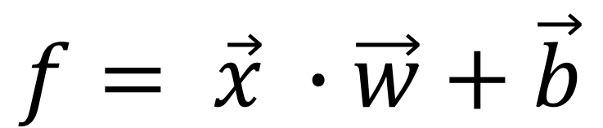
Multi variable
$$f= \vec{x} ∙\vec{w}+\vec{b}$$

Slide 19

Multi variable
$$f\left(x_{1},x_{2},x_{3}\right)=w_{1}x_{1}+w_{2}x_{2}+w_{3}x_{3}+\vec{b}$$

Slide 20
Linear regression
https://youtu.be/sQYNuwvpNk8

Slide 21
Lab Session

